Slide 1

PES’s Modern College of Engineering, Shivajinagar, Pune-5. Department of Electronics and Telecommunication A.Y. - 2021-22
Project ID- A8
Dry/ Wet Garbage Segregation and Monitoring
1. Omkar Bhilare -32006
2. Rishikesh Datey -32016
3. Neha Ghogare - 32030
Name of The Guide :
Mr. Ramgopal Sahu

Slide 2

PES’s Modern College of Engineering, Shivajinagar, pune-5. Department of Electronics and Telecommunication
Overview : (Times New Roman Font 24)
Introduction
Literature Survey: Market (Product, components) Research Paper survey.
System Specifications
Block Diagram
Hardware Design: Simulation, Circuit Diagram, PCB artwork
Software Design (Flow Chart or Algorithm)
Result (Photo / Audio-Visual / Video Results)
Applications
Conclusion
Future Scope
References
Title of the Project

Slide 3
Introduction
This work is concerned with the issues of Municipal solid waste management in India with Emphasis on problems related to disposed by landfills.
Today’s era its big problem to consume waste. Day by day all types garbage increasing very fast and its harmful to human’s and societies.
The main importance is to separation of garbage in Wet and Dry category. This project we made a smart garbage box for this speration auto.

Slide 4
Literature Survey: Market (Product, components) Research Paper survey
Serial no. | Year of public-ation | Title / Author | Methodology / Features | Limitations
1 | 2014 | “Design and development of smart waste subsystem” by “Ravena singh” | The author suggested that solid waste management is the big problem now days. Solid waste can be categorized into two different types; biodegradable and nonbiodegradable waste. | The system can be made waterproof. The system should be cheap and approachable
2 | 2015 | Smart bin implementation for smart cities” (International Journal of Scientific & Engineering Research) by “Narayan sharma, ” | The author describes that the application of smart bin in the managing of the waste collection system of an entire city. | cost of making it were quite high

Slide 5
3 | 2017 | “Automatic waste segregation system” (National Conference on Communication and Image processing) by “Amruta chandramohanet” | It describes an India about an automatic waste segregating system which is chip and easy to used, solution for segregating the waste at household level. | Sensor nodes used in the dustbins have limited memory size.
4 | 2018 | “Smart dustbin” (International Journal for Research in Applied Science & Engineering Technology) by “Twinkle singha, K Mukesh kumar” | It suggested that smart bin is built on microcontroller based platform; waste management has been a crucial issue to be considering this paper is way to achieve good cost. | Error is used in detection when wet waste passes on the conveyer belt making it wet

Slide 6
System Specifications
When the object (waste) is placed on the plank one by one IR sensor detects the object.
Depending upon the type of object(wet /dry) placed on the plank, moisture sensor detects whether the object is wet or dry.
If the object contains moisture then servo motor send object into the Left Chamber.
If the object does not contains any moisture then servo motor send object into the Right Chamber.
Ultrasonic sensor is use to measure the junk level of both the chamber.
LCD display will show the remaining space in Chamber (in %) and count of objects put in both the chamber.

Slide 7
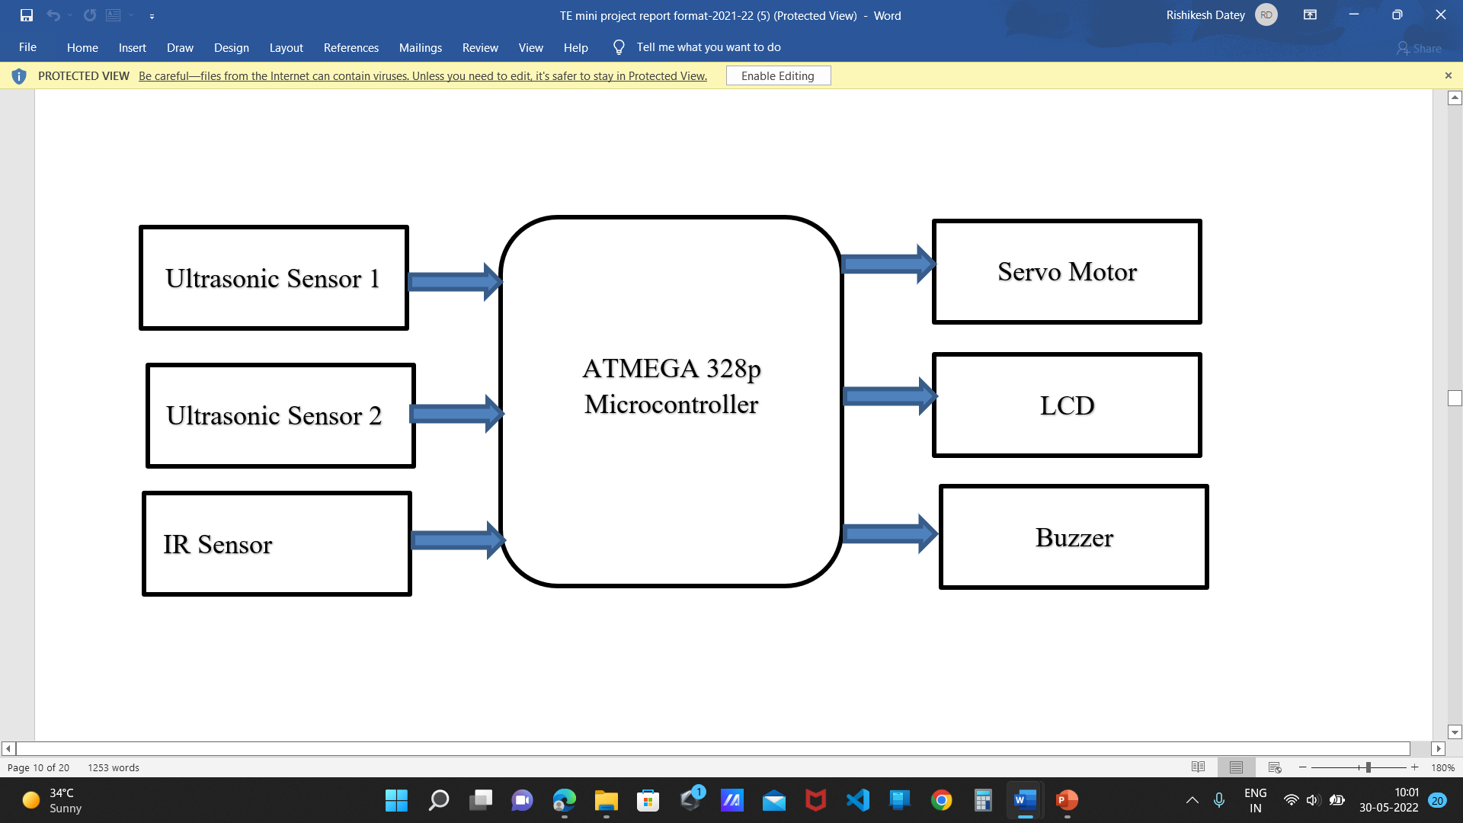







Block Diagram
Power supply

Slide 8
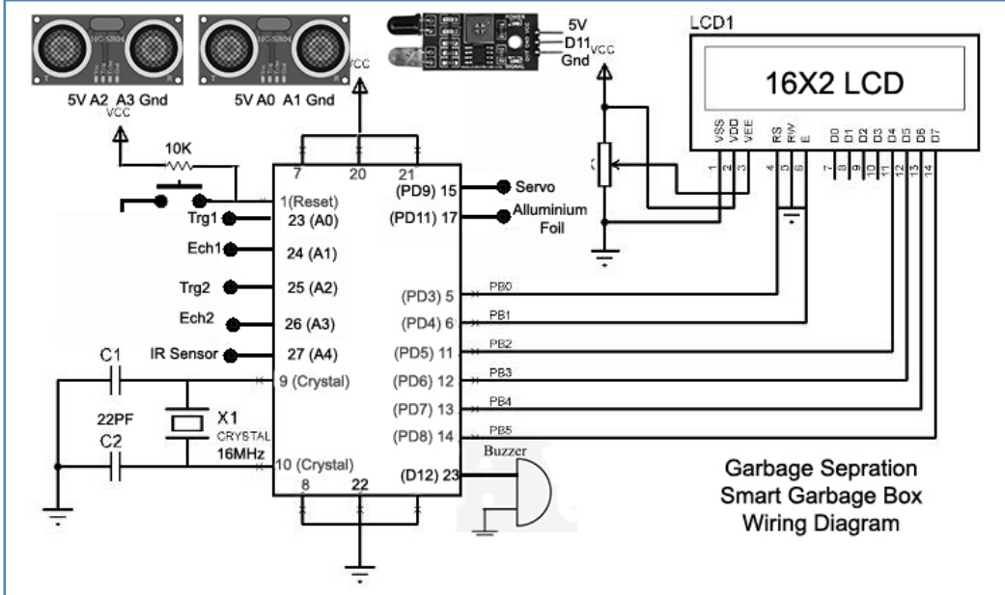
Hardware Design: Circuit Diagram, PCB artwork
Circuit diagram

Slide 9
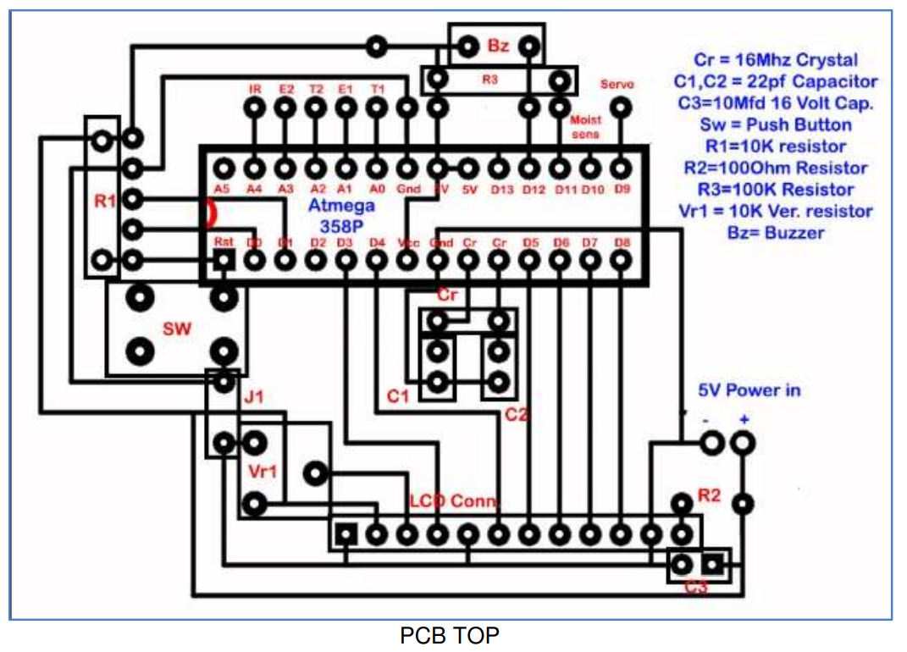
PCB artwork

Slide 10
T1 & E1 = Ultrasonic sensor 1 Trigger pin and Echo Pin
T2 & E2 = Ultrasonic sensor 2 Trigger pin and Echo Pin
Ir = Ir Sensor signal Pin
Servo = to servo motor
Moist Sensor = to moisture sensor (Aluminium foil)

Slide 11
Software Design (Flow Chart or Algorithm)
Start
Placing Object
IR sensor detects the objects
Moisture present
YES
Chamber 1
(Wet Waste)
NO
Chamber 2
(Dry Waste)
Ultrasonic sensor sends a message when garbage is full
NO
YES
Display alert on LCD
Stop

Slide 12
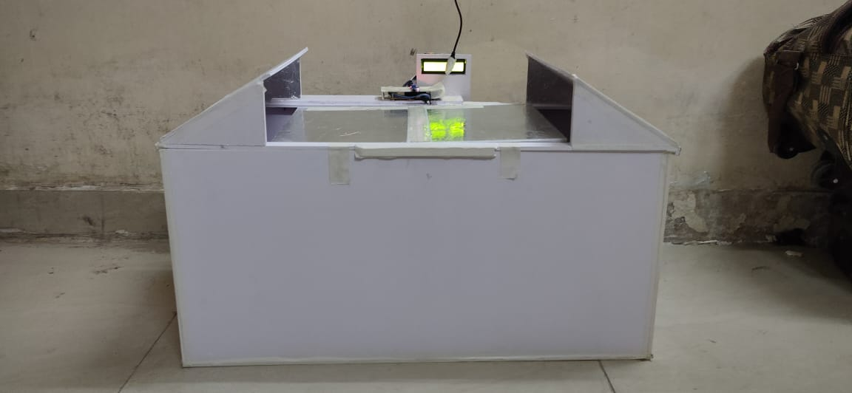
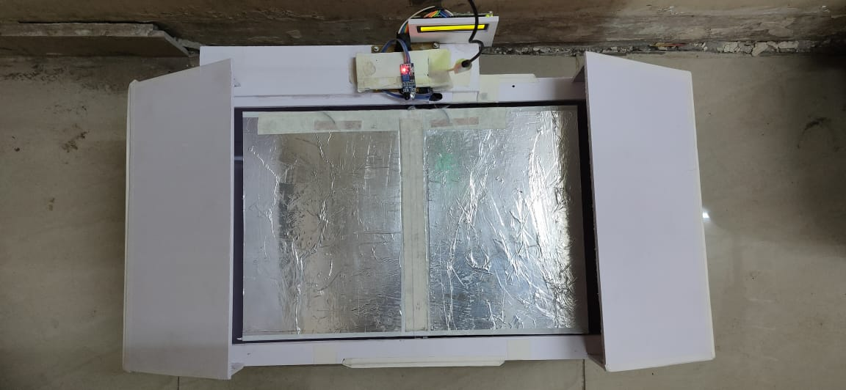
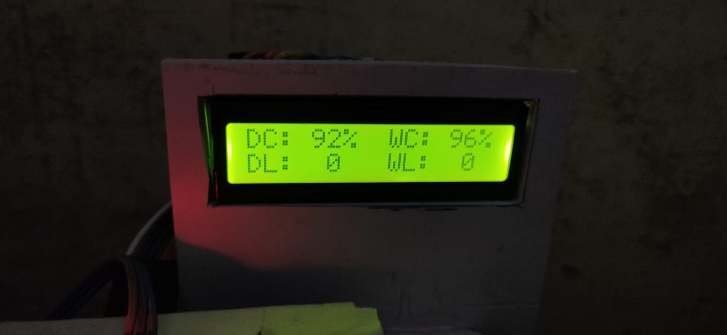
Results
Front View
Top View
LCD Display

Slide 13
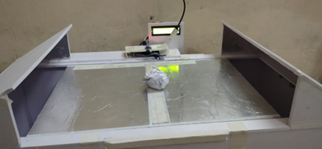
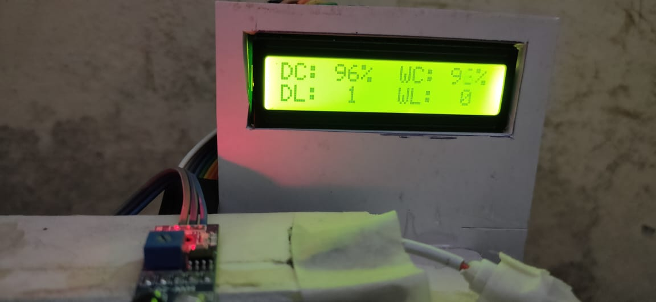
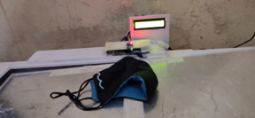
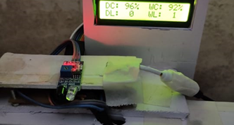
Fig. 1.1 Dry Waste
Fig. 1.2 Dry waste output
Fig. 1.3Wet Waste
Fig. 1.4 wet waste output

Slide 14
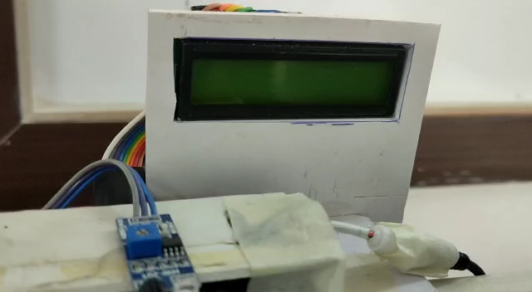
Dry Garbage Video

Slide 15
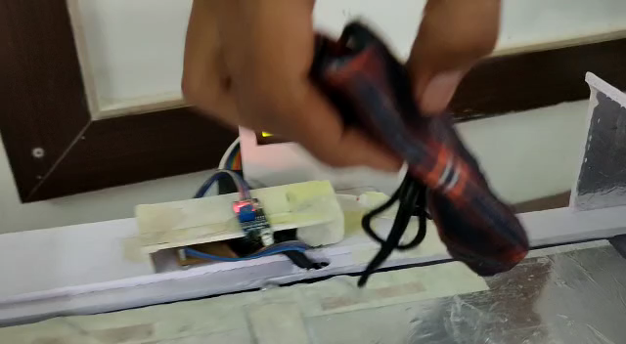
Wet Garbage Video

Slide 16
Applications
It can be used for collecting the garbage from public palces, household, etc
Reducing human time and effort which requires to segregate garbage.
Municipal Corporation can use it as replacement to the traditional dustbins.

Slide 17
Conclusion
Automatic Waste Segregator can be successfully implement for the separation of waste into dry and wet waste at a domestic level.
The system can segregate only one type of waste at a time with an assigned priority for wet and dry waste.
It helps in minimizing the efforts along with reducing pollution and energy consumption which is associated with manufacturing new materials form waste.

Slide 18
Future Scope
This Project is an innovative step in the direction of bringing a change in the current garbage disposal system. Further the self-charging technology can be implemented so that the battery of the smart bin is low on power then using solar tracker.
The waste segregator can be improvised to include the separation of paper and plastic, safe segregation of biomedical waste generated at home, compact and aesthetic Mechanical design.

Slide 19
References
Kavya sahana, Shruti, Sunitha, “Senor based smart dustbin for waste segregation,” Department of extc.
Nishigandha kothari, “waste to wealth, NSWAI” New delhi, July 2013.
“Automation of waste segregation system using PLC”, Rashmi M. Kittali and Ashok Sutagundar, 29/10/2016

